Slide 1
Rockbuster Sealth LLC Online Video Service Blueprint
Tatum Zeliadt

Slide 2
Rockbuster Sealth Data Analysis Project
Goal
Objective
Motivation
Stay competitive with streaming services such as Netflix and Amazon Prime
Determine which movies and regions have highest revenue to market service
Use existing movie license to launch an online video rental service

Slide 3
Highlights of Current Rental Market
Circulate to 109 Countries
599 Consumers
Distribute 1000 Films
Total Revenue $61312.04

Slide 4
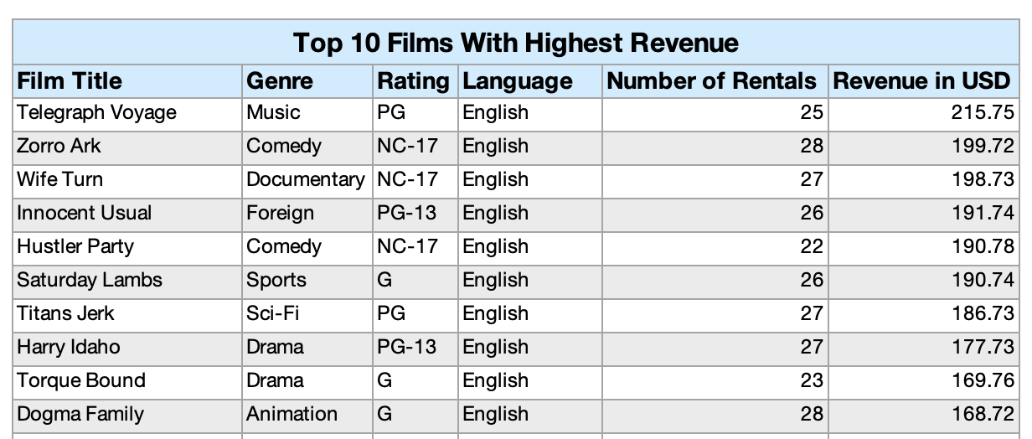
Which movies contributed the most to revenue gain?
Total Film Revenue $61312.04

Slide 5
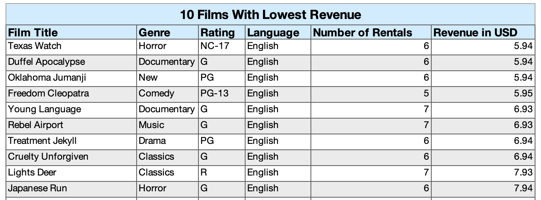

Which movies contributed the least to revenue gain?

Slide 6
Total Revenue by Genre

Slide 7
Top 3 Genre in Revenue
Sports
Sci-Fi
Animation

Slide 8
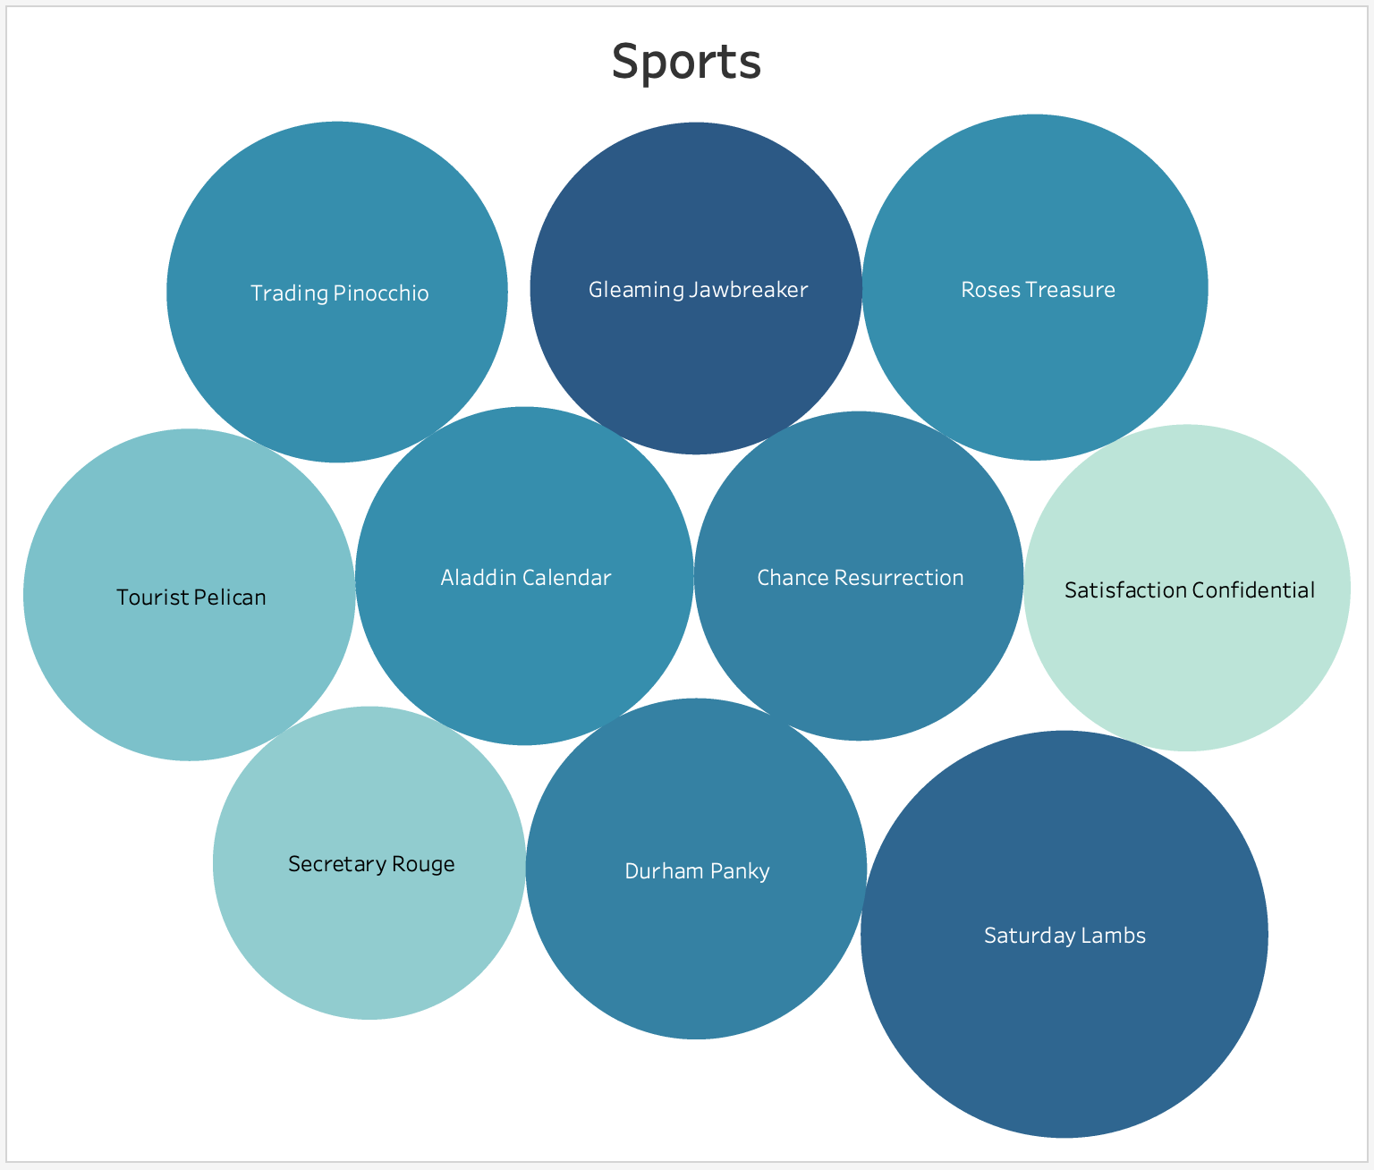
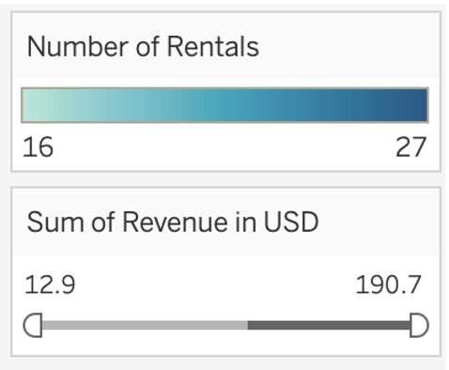
Top Movies in Sport Genre by Revenue and Rentals

Slide 9
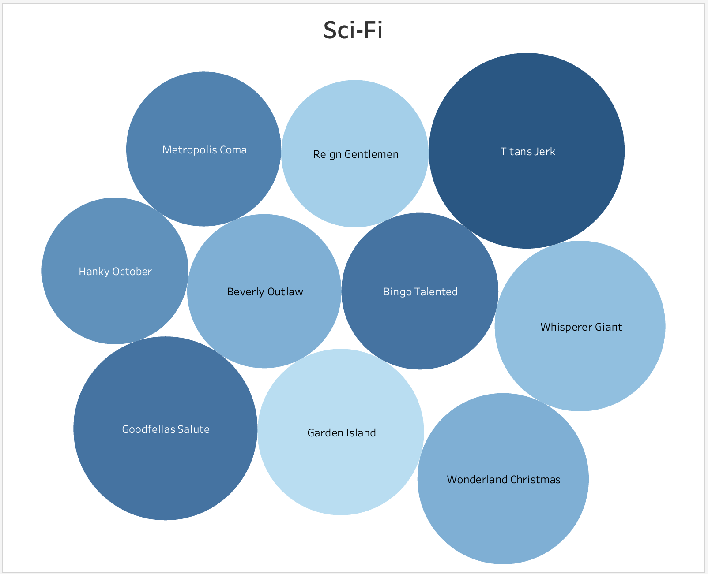
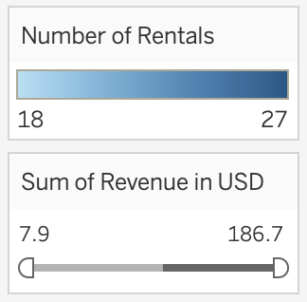
Top Movies in Sci-Fi Genre by Revenue and Rentals

Slide 10
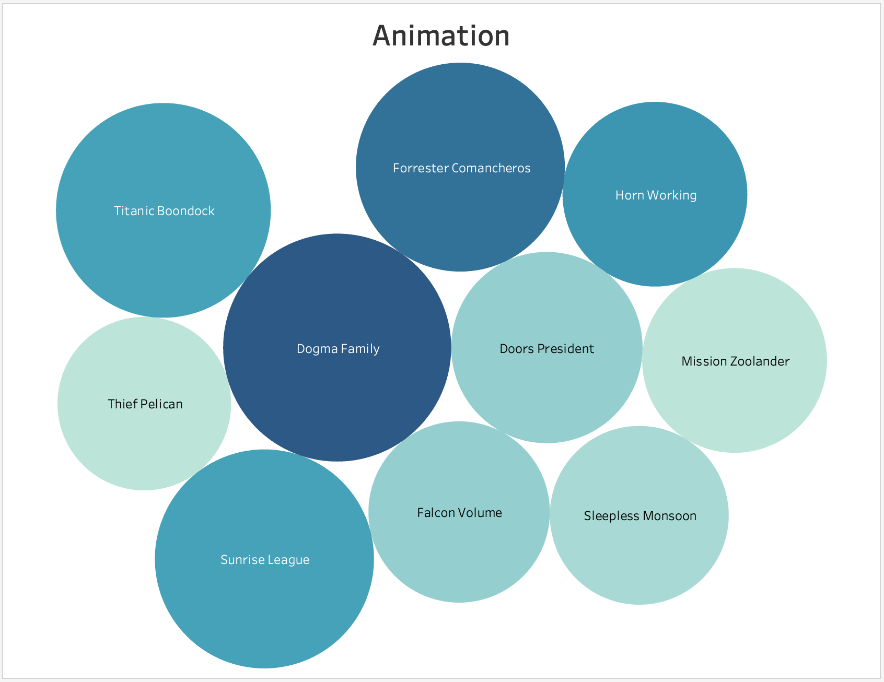
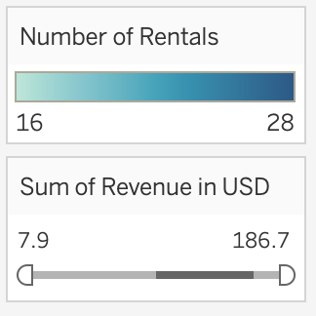
Top Movies in Animation Genre by Revenue and Rentals

Slide 11
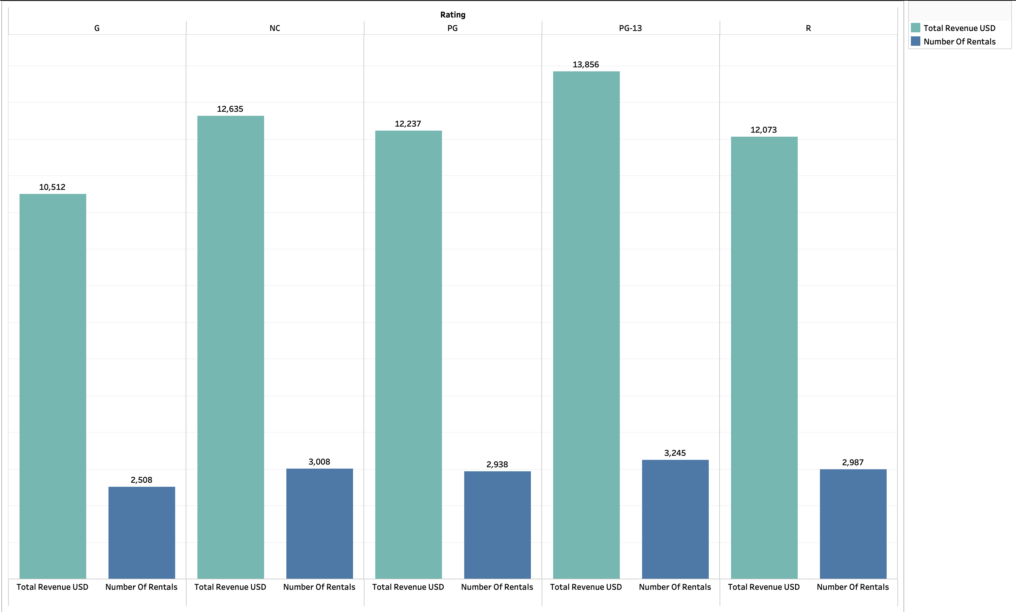
Revenue and Number of Rentals by Rating

Slide 12

TOP FILM TITLES BY RATING

Slide 13
TOP FILM TITLES BY RATING

Slide 14
TOP FILM TITLES BY RATING

Slide 15
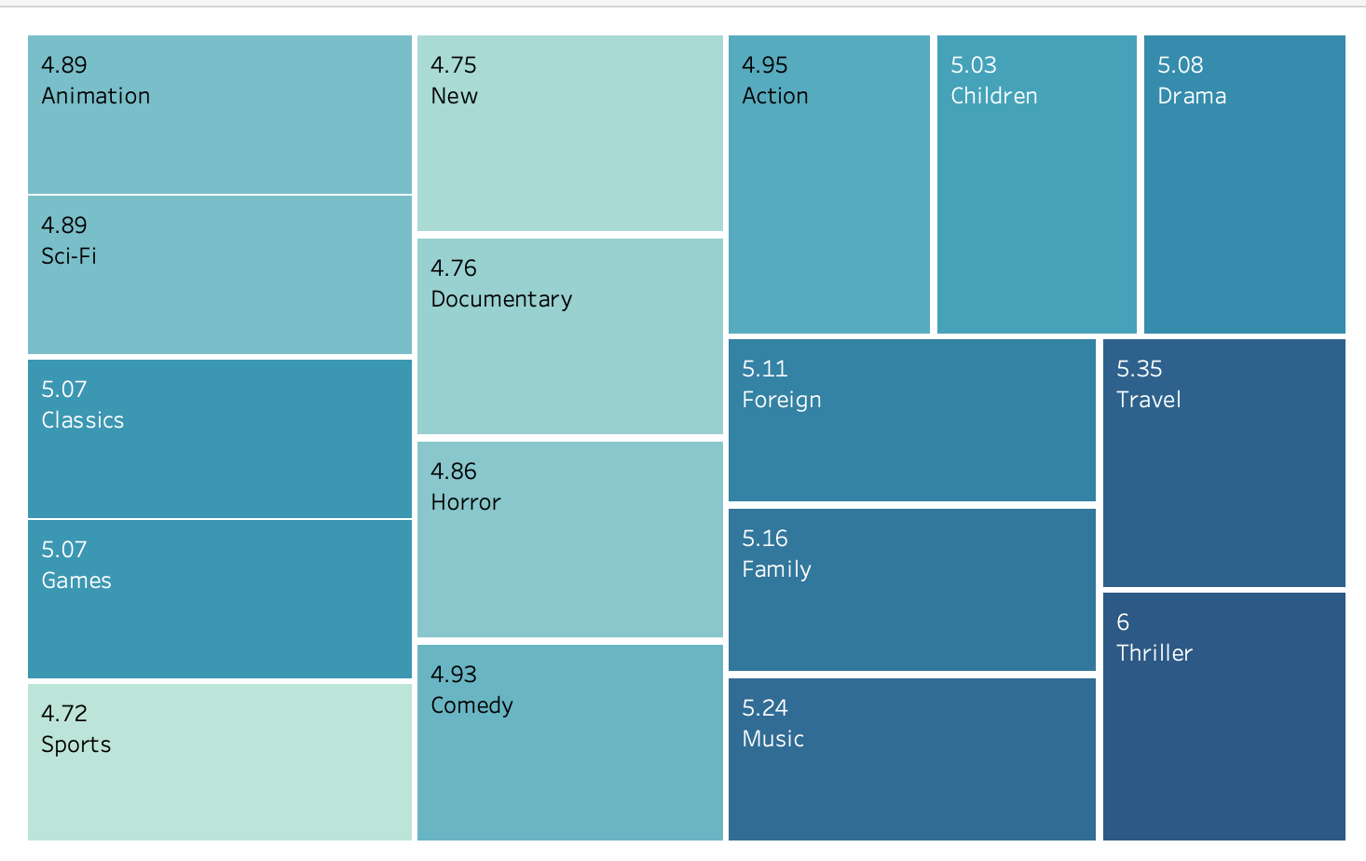
What was the average rental duration for all videos?
Average Duration of Rental (Days) - Genre
Duration of Rental (Days) - Rating
Rating | Avg. Rental Length | Minimum Rental | Maximum Rental
G | 4.84 | 3 | 7
PG | 5.08 | 3 | 7
PG-13 | 5.05 | 3 | 7
R | 4.77 | 3 | 7
NC-17 | 5.14 | 3 | 7
TOTAL | 4.98 | 3 | 7
Total | 5.05 | 3 | 7

Slide 16
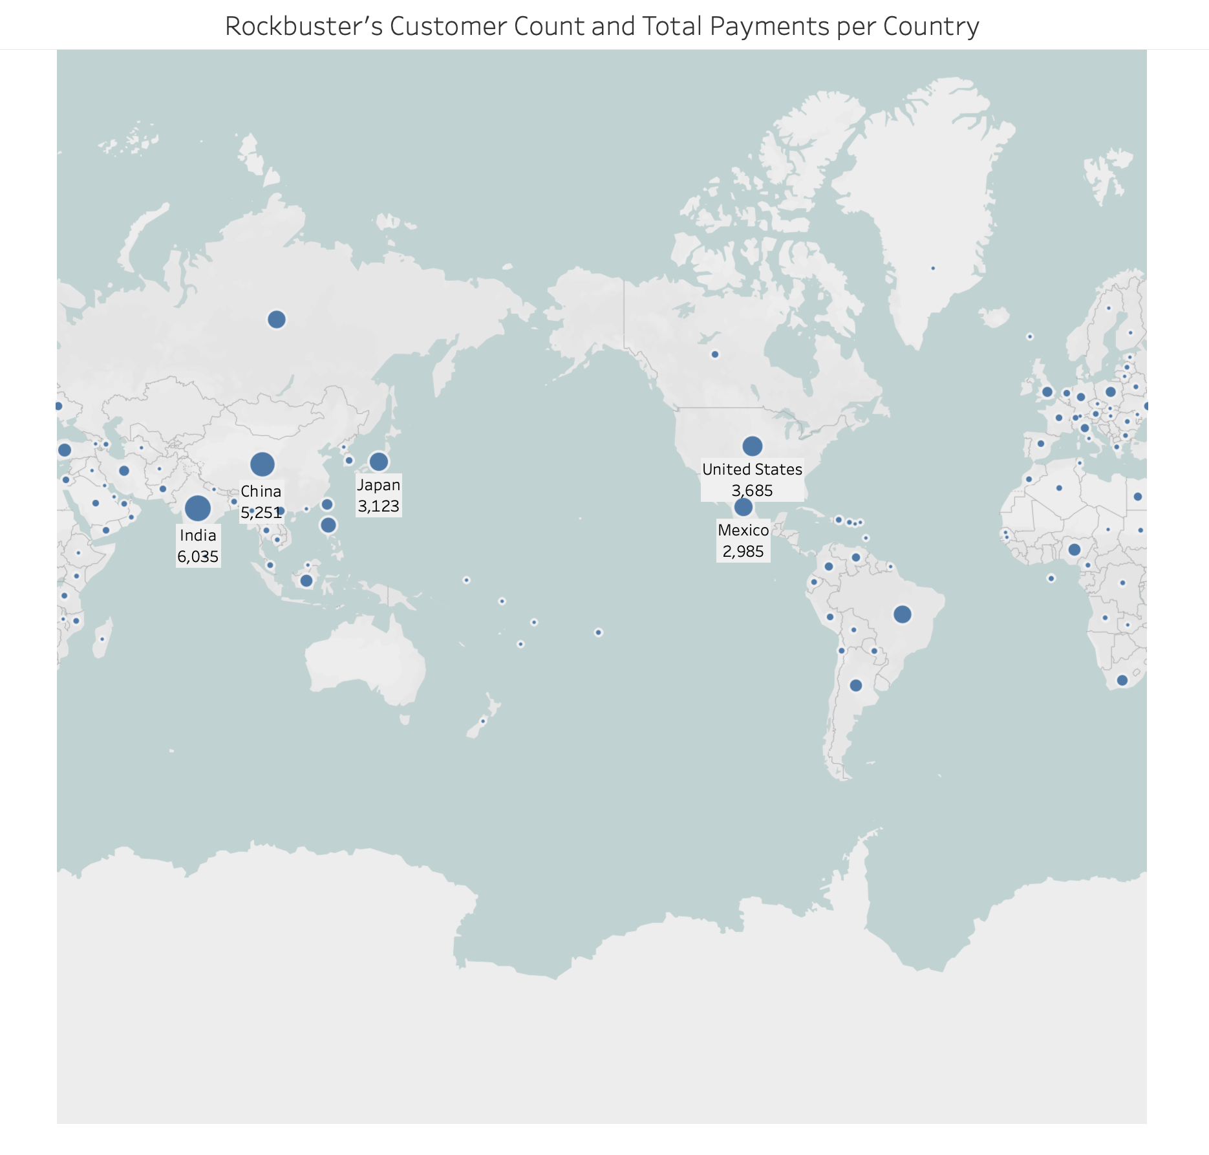
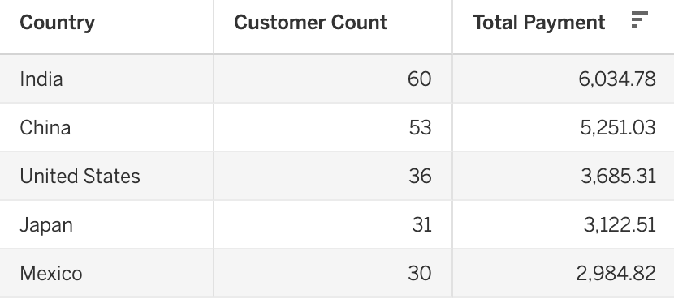
Top 5 Countries by Top Customer Payments

Slide 17
Revenue of Top 5 Customers Within Leading City/ Countries

Slide 18
Recommendations
Prioritize the top countries of India, China, US, Japan and Mexico for initiation.
Release Year for all movies was in 2006, diversify the collection.
Prioritize the top genres in Sports, Sci-Fi and Animation for initial release.
Increase the number of Thriller films.
Offer streaming packages (single rental, monthly, unlimited)

Slide 19
Thank you

